Slide 1
UNIT 3: COMBINATIONAL LOGIC CIRCUITS
II CSE – AIML, BDA

Slide 2
CONTENTS
Quine-McCluskey minimization technique,
Combinational Circuits ,
Multiplexer, Demultiplexer,
Decoder, Encoder,
Binary adder , Binary adder as subtractor, Carry look ahead adder, Decimal adder,
Magnitude Comparator,
Read Only Memory,
Arithmetic Logic Unit, Programmable Logic Arrays,
HDL Gate and Data Flow modeling , HDL Behavioral modeling , Problem solving session

Slide 3
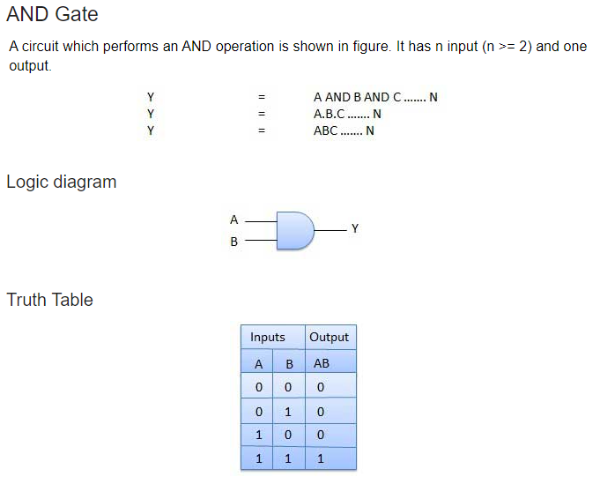
Logic Gates

Slide 4
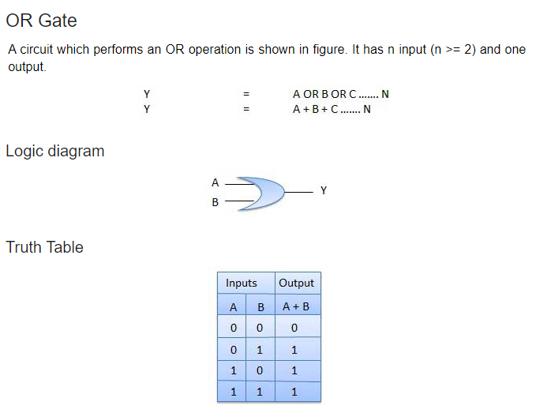
Logic Gates

Slide 5
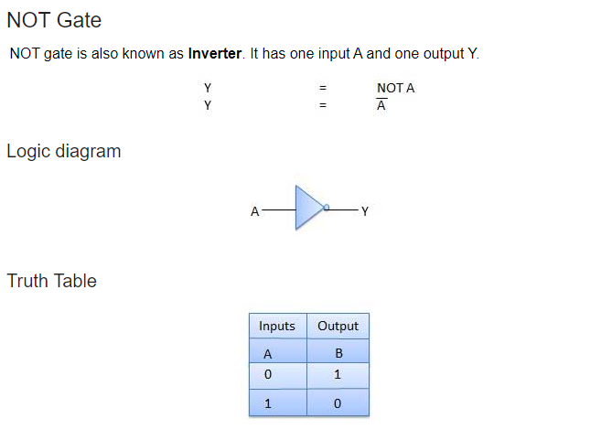
Logic Gates

Slide 6
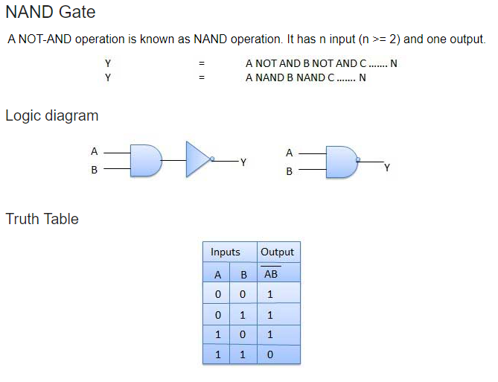
Logic Gates

Slide 7
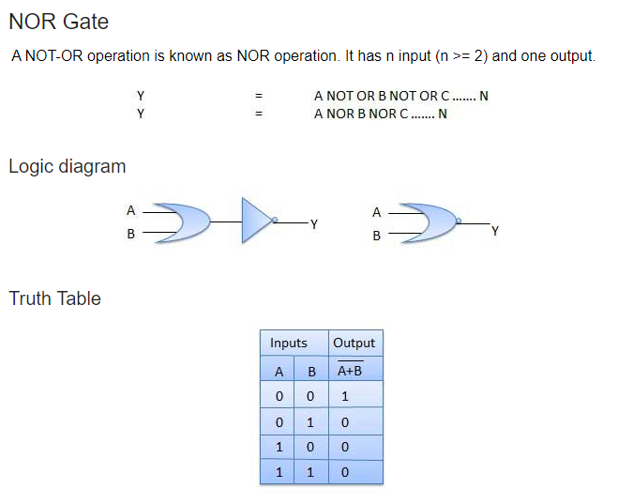
Logic Gates

Slide 8
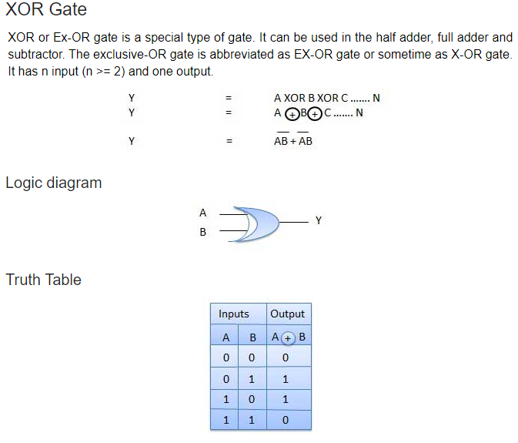
Logic Gates

Slide 9
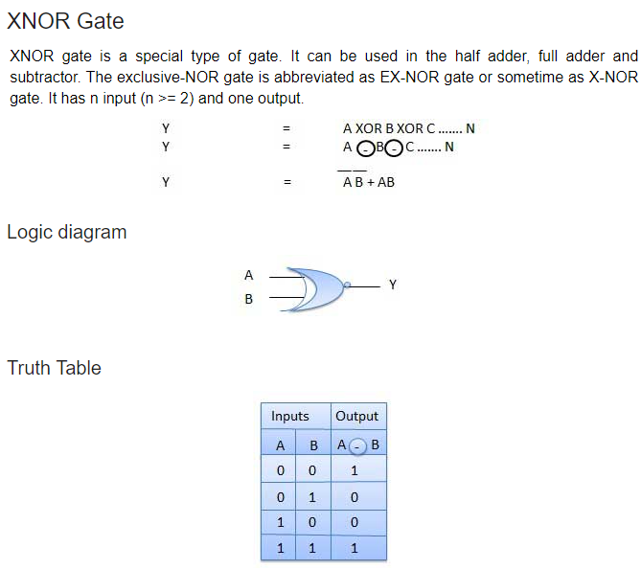
Logic Gates

Slide 10
INTRODUCTION

Slide 11
Boolean Algebra
To perform the logical operation with minimum logic gates, a set of rules were invented, known as the Laws of Boolean Algebra. These rules are used to reduce the number of logic gates for performing logic operations.
The Boolean algebra is mainly used for simplifying and analyzing the complex Boolean expression. It is also known as Binary algebra because we only use binary numbers in this. George Boole developed the binary algebra in 1854.
Rules in Boolean algebra
Only two values(1 for high and 0 for low) are possible for the variable used in Boolean algebra.
The overbar(-) is used for representing the complement variable. So, the complement of variable C is represented as .
The plus(+) operator is used to represent the ORing of the variables.
The dot(.) operator is used to represent the ANDing of the variables.

Slide 12
Properties of Boolean algebra
Identity Law
When the variable is AND with 1 and OR with 0, the variable remains the same, i.e.,
B.1 = B
B+0 = B
Idempotent Law
When the variable is AND and OR with itself, the variable remains same or unchanged, i.e.,
B.B = B
B+B = B
Complement Law
When the variable is AND and OR with its complement, it will give the result 0 and 1 respectively.
B.B' = 0
B+B' = 1

Slide 13
Properties of Boolean algebra
Double Negation Law
This law states that, when the variable comes with two negations, the symbol gets removed and the original variable is obtained.
((A)')' = A
Commutative Law
This law states that no matter in which order we use the variables. It means that the order of variables doesn't matter in this law.
A.B = B.A
A+B = B+A
Associative Law
This law states that the operation can be performed in any order when the variables priority is of same.
(A.B).C = A.(B.C)
(A+B)+C = A+(B+C)

Slide 14
Properties of Boolean algebra
Distributive Law
This law allows us to open up of brackets. Simply, we can open the brackets in the Boolean expressions.
A+(B.C) = (A+B).(A+C)
A.(B+C) = (A.B)+(A.C)
Absorption Law
This law allows us for absorbing the similar variables.
B+(B.A) = B
B.(B+A) = B
De Morgan Law
The operation of an OR and AND logic circuit will remain same if we invert all the inputs, change operators from AND to OR and OR to AND, and invert the output.
(A.B)' = A'+B'
(A+B)' = A'.B'

Slide 15
Simplifying Boolean Expression
Simplify: (A + C)(AD + AD) + AC + C

Slide 16
Simplifying Boolean Expression
Simplify: f(A,C,D) = (A + C)(AD + AD) + AC + C

Slide 17
Simplifying Boolean Expression
There are two methods which are used for simplifying Boolean function. These functions are as follows:
Karnaugh-map or K-map
Quine-McCluskey minimization technique.
Consider: f(A,C,D) = (A + C) (A + A) (A+ D)
Consider : f(A,C,D) = (A C+ CD + AD)

Slide 18
Min Term and Max Term
Consider: f(A,B,C) = (A + B + C) (A + B’ + C’)
Consider : f(A,B,C) = (A’ B C’ + AB’C )

Slide 19
Min Term and Max Term
Maxterm:
A maxterm is a sum term in boolean function in which every element is present is either in normal or in complemented form. Example: F(a,b,c), the possible maxterms would be (a+b+c), (a+b+c’), (a+b’+c), ( a+b’+c’), (a’+b+c), ( a+b’+c), ( a’+b’+c), (a’+b’+c’) .
It is also called as conjunctive normal form(CNF).
The value correspond to 0 or false is selected as maxterm.
Minterm:
A minterm is a product term in boolean function in which every element is present is either in normal or in complemented form.
Example: F(a,b,c) is a boolean function. The possible minterms would be abc, abc’, ab’c, ab’c’, a’bc, ab,c, a’b’c, a’b’c’ .
It is also called as disjunctive normal form(DNF). The value correspond to 1 or true is selected as minterm.
Note: For n varibale boolean function there would be 2^n possible minterms.

Slide 20

Truth Table for Binary Coded Decimal
Decimal Number | BCD 8421 Code
0 | 0000 0000
1 | 0000 0001
2 | 0000 0010
3 | 0000 0011
4 | 0000 0100
5 | 0000 0101
6 | 0000 0110
7 | 0000 0111
8 | 0000 1000
9 | 0000 1001
10 (1+0) | 0001 0000
11 (1+1) | 0001 0001
12 (1+2) | 0001 0010
… | …
20 (2+0) | 0010 0000
21 (2+1) | 0010 0001
22 (2+2) | 0010 0010
etc, continuing upwards in groups of four

Slide 21
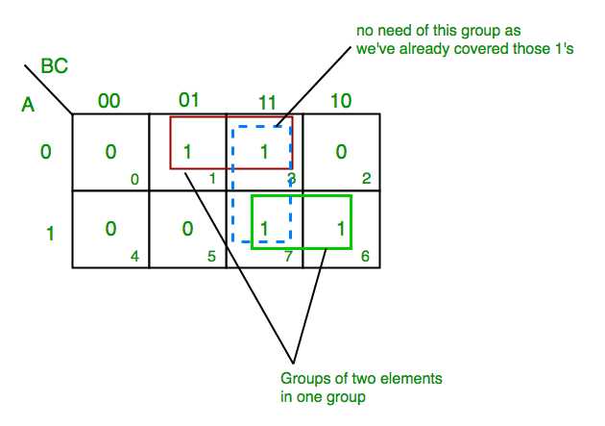
K-Map
K-map of 3 variables-
Design the Boolean Expression for the
f(Z)= ∑m(1,3,6,7)
From red group we get product term—
A’C
From green group we get product term—
AB
Summing these product terms we get- Final expression (A’C+AB)

Slide 22
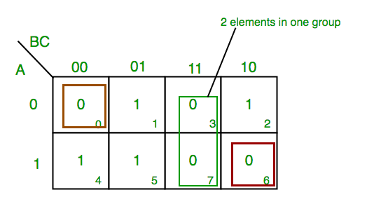
K-Map
Find the Boolean Expression for the Boolean Function,
f(Z)=πM(0,3,6,7)
From red group we find terms
A B C’
Taking complement of these two
A’ B’ C
Now sum up them
(A’ + B’ + C)
From green group we find terms
B C
Taking complement of these two terms
B’ C’
Now sum up them
(B’+C’)
From brown group we find terms
A’ B’ C’
Taking complement of these two
A B C
Now sum up them
(A + B + C)
We will take product of these three terms :Final expression (A’ + B’ + C) (B’ + C’) (A + B + C)

Slide 23
Implicant
Implicant is a product/minterm term in Sum of Products (SOP) or sum/maxterm term in Product of Sums (POS) of a Boolean function.
E.g., consider a boolean function, F = AB + ABC + BC.
Implicants are AB, ABC and BC.
OR
E.g., consider a boolean function, F = (A+B)(A+B+C)(B+C).
Implicants are A+B, A+B+C and B+C.

Slide 24
Prime Implicant
A group of square or rectangle made up of bunch of adjacent minterms which is allowed by definition of K-Map are called prime implicants(PI) i.e. all possible groups formed in K-Map.
Example:

Slide 25
Essential Prime Implicant
These are those subcubes(groups) which cover atleast one minterm that can’t be covered by any other prime implicant.
Essential prime implicants(EPI) are those prime implicants which always appear in final solution.

Slide 26
Quine-McCluskey minimization technique,
K-map method, is a convenient method for minimizing Boolean functions up to 5 variables.
But, it is difficult to simplify the Boolean functions having more than 5 variables by using this method.
Quine-McClukey tabular method is a tabular method based on the concept of prime implicants.

Slide 27
Quine-McCluskey minimization technique,
Follow these steps for simplifying Boolean functions using Quine-McClukey tabular method.
Step 1 − Arrange the given min terms in an ascending order and make the groups based on the number of ones present in their binary representations. So, there will be at most ‘n+1’ groups if there are ‘n’ Boolean variables in a Boolean function or ‘n’ bits in the binary equivalent of min terms.
Step 2 − Compare the min terms present in successive groups. If there is a change in only one-bit position, then take the pair of those two min terms. Place this symbol ‘_’ in the differed bit position and keep the remaining bits as it is.
Step 3 − Repeat step2 with newly formed terms till we get all prime implicants.
Step 4 − Formulate the prime implicant table. It consists of set of rows and columns. Prime implicants can be placed in row wise and min terms can be placed in column wise. Place ‘1’ in the cells corresponding to the min terms that are covered in each prime implicant.

Slide 28
Quine-McCluskey minimization technique,
Step 5 − Find the essential prime implicants by observing each column. If the min term is covered only by one prime implicant, then it is essential prime implicant. Those essential prime implicants will be part of the simplified Boolean function.
Step 6 − Reduce the prime implicant table by removing the row of each essential prime implicant and the columns corresponding to the min terms that are covered in that essential prime implicant. Repeat step 5 for Reduced prime implicant table. Stop this process when all min terms of given Boolean function are over.

Slide 29
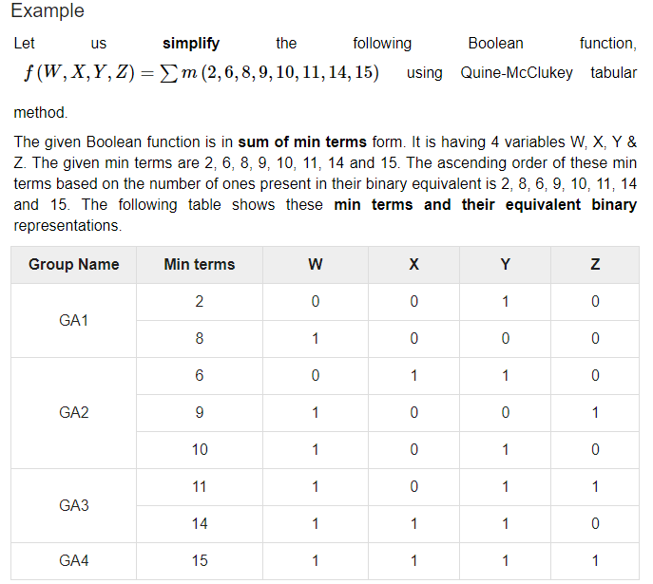

Slide 30
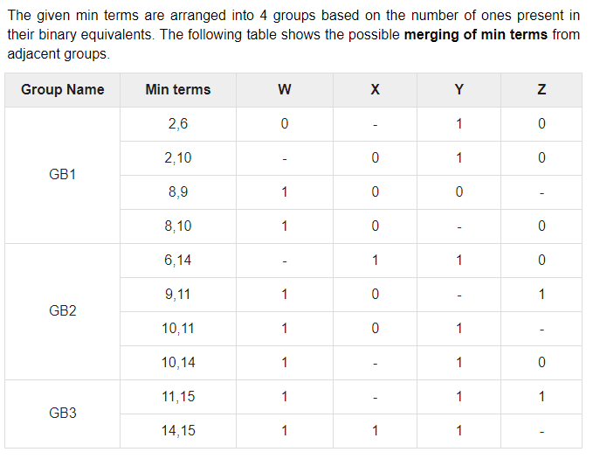

Slide 31
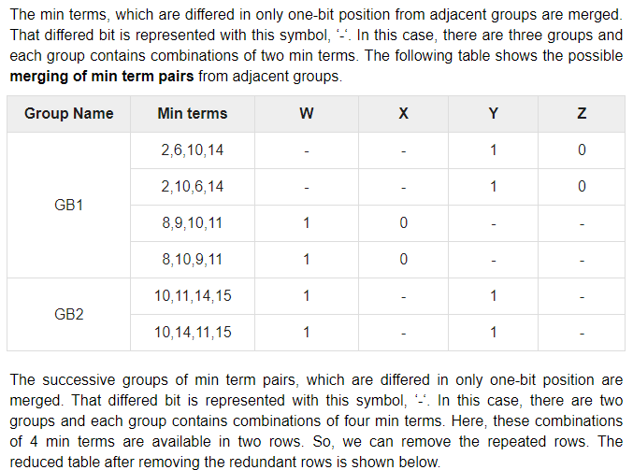

Slide 32
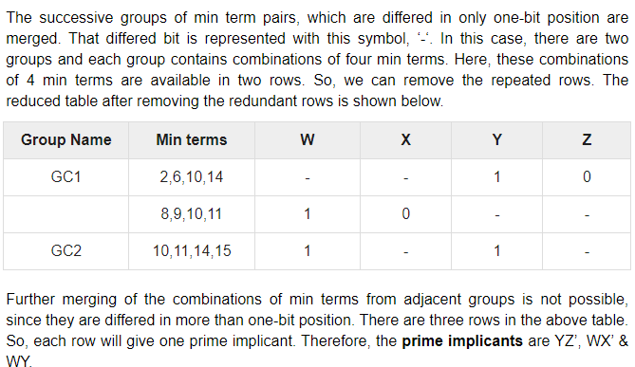

Slide 33
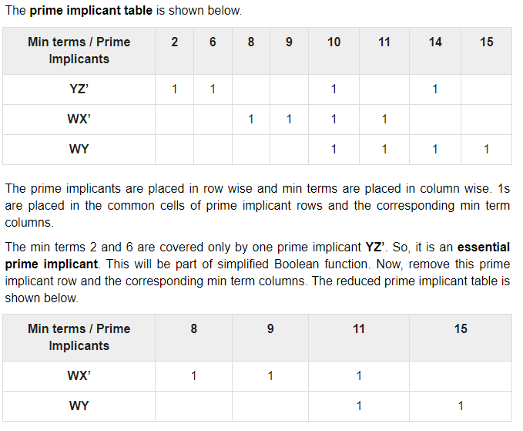

Slide 34
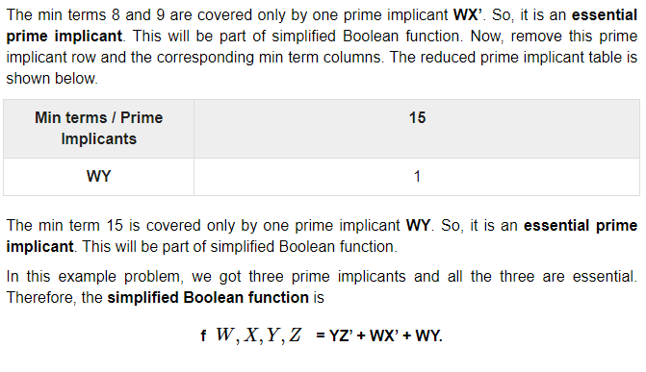

Slide 35
CONTENTS
Quine-McCluskey minimization technique,
Combinational Circuits ,
Multiplexer, Demultiplexer,
Decoder, Encoder,
Binary adder , Binary adder as subtractor, Carry look ahead adder, Decimal adder,
Magnitude Comparator,
Read Only Memory,
Arithmetic Logic Unit,
Programmable Logic Arrays,
HDL Gate and Data Flow modeling ,
HDL Behavioral modeling

Slide 36
Combinational Circuits
The combinational logic circuits are the circuits that contain different types of logic gates. Simply, a circuit in which different types of logic gates are combined is known as a combinational logic circuit.
The output of the combinational circuit is determined from the present combination of inputs, regardless of the previous input.
The input variables, logic gates, and output variables are the basic components of the combinational logic circuit.
There are different types of combinational logic circuits, such as Adder, Subtractor, Decoder, Encoder, Multiplexer, and De-multiplexer.

Slide 37
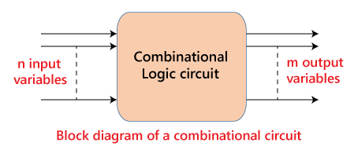
Combinational Circuits

Slide 38
Characteristics of Combinational Circuits
At any instant of time, the output of the combinational circuits depends only on the present input terminals.
The combinational circuit doesn't have any backup or previous memory. The present state of the circuit is not affected by the previous state of the input.
The n number of inputs and m number of outputs are possible in combinational logic circuits.

Slide 39
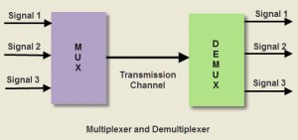
MULTIPLEXER and DEMULTIPLEXER
Both the multiplexer and demultiplexer are combinational circuits.
A multiplexer selects an input from several inputs then it is transmitted in the form of a single line.
An alternative name of the multiplexer is MUX or data selector.
A demultiplexer uses one input signal and generates many output signal. So it is known as Demux or data distributor.

Slide 40
Applications of Multiplexer
Following are some of the applications of multiplexers –
Communication System –Multiplexer allow the process of transmitting different type of data such as audio, video at the same time using a single transmission line.
Telephone Network – In telephone network, multiple audio signals are integrated on a single line for transmission with the help of multiplexers. In this way, multiple audio signals can be isolated and eventually, the desire audio signals reach the intended recipients.
Computer Memory – Multiplexers are used to implement huge amount of memory into the computer, at the same time reduces the number of copper lines required to connect the memory to other parts of the computer circuit.
Transmission from the Computer System of a Satellite – Multiplexer can be used for the transmission of data signals from the computer system of a satellite or spacecraft to the ground system using the GPS (Global Positioning System) satellites.

Slide 41
Quiz
Multiplexer is also called ______ or ______.
A. Demux, Data Distributor
B. Mux, Data Selector
C. Demux, Data Selector
D. Mux, Data Distributor
Ans. B. Mux, Data Selector

Slide 42
Multiplexer AND Demultiplexer Types
MUX:
2-1 multiplexer ( 1select line)
4-1 multiplexer (2 select lines)
8-1 multiplexer(3 select lines)
16-1 multiplexer (4 select lines)
DEMUX:
1-2 demultiplexer (1 select line)
1-4 demultiplexer (2 select lines)
1-8 demultiplexer (3 select lines)
1-16 demultiplexer (4 select lines)

Slide 43
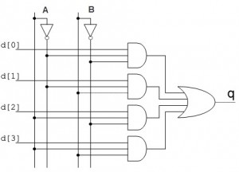
4-to-1 Multiplexer

Slide 44
Advantages of Multiplexer
In multiplexer, the usage of a number of wires can be decreased
It reduces the cost as well as the complexity of the circuit
The implementation of a number of combination circuits can be possible by using a multiplexer
Mux doesn’t require K-maps & simplification
The multiplexer can make the transmission circuit less complex & economical
The dissipation of heat is less because of the analog switching current which ranges from 10mA to 20mA.
The multiplexer ability can be extended to switch audio signals, video signals, etc.
The digital system reliability can be improved using a MUX as it decreases the number of exterior wired connections.
MUX is used to implement several combinational circuits
The logic design can be simplified through MUX

Slide 45
Disadvantages of Multiplexer
Additional delays required within switching ports & I/O signals which propagate throughout the multiplexer.
The ports which can be utilized at the same time have limitations
Switching ports can be handled by adding the complexity of firmware
The controlling of multiplexer can be done by using additional I/O ports.

Slide 46
Quiz
Identify the incorrect advantages of Multiplexer:
A. Mux require K-maps & simplification
B. The multiplexer can make the transmission circuit less complex & economical
C. The dissipation of heat is less because of the analog switching current which ranges from 10mA to 20mA.
D. The multiplexer ability can be extended to switch audio signals, video signals, etc.
Ans. A. Mux require K-maps & simplification

Slide 47
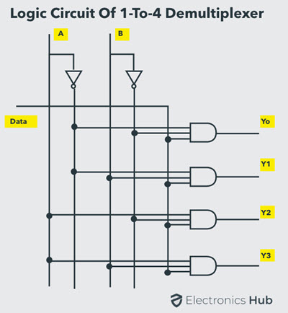
1-to-4 demultiplexer
The 1-to-4 demultiplexer has 1 input bit, 2 control or select bits, and 4 output bits

Slide 48
Applications of Demultiplexer
Demultiplexer: Most of the communication system are bidirectional i.e., they function in both ways (transmitting and receiving signals). Hence, for most of the applications, the multiplexer and demultiplexer work in sync. Demultiplexer are also used for reconstruction of parallel data and ALU circuits.
Communication System – Communication system use multiplexer to carry multiple data like audio, video and other form of data using a single line for transmission. The demultiplexer receive the output signals of the multiplexer and converts them back to the original form of the data at the receiving end.
Note: The multiplexer and demultiplexer work together to carry out the process of transmission and reception of data in communication system.

Slide 49
Applications of Demultiplexer
ALU (Arithmetic Logic Unit) – In an ALU circuit, the output of ALU can be stored in multiple registers or storage units with the help of demultiplexer. The output of ALU is fed as the data input to the demultiplexer. Each output of demultiplexer is connected to multiple register which can be stored in the registers.
Serial to Parallel Converter – A serial to parallel converter is used for reconstructing parallel data from incoming serial data stream. In this technique, serial data from the incoming serial data stream is given as data input to the demultiplexer at the regular intervals. A counter is attached to the control input of the demultiplexer. This counter directs the data signal to the output of the demultiplexer where these data signals are stored. When all data signals have been stored, the output of the demultiplexer can be retrieved and read out in parallel.

Slide 50
Advantages of Demultiplexer
A demultiplexer or Demux is used to divide the mutual signals back into separate streams.
The function of Demux is quite opposite to MUX.
The Audio or Video signals transmission needs a combination of Mux and Demux.
Demux is used as a decoder within the security systems of banking sectors.
The communication system efficiency can be enhanced through the combination of Mux & Demux.

Slide 51
Disadvantages of Demultiplexer
Bandwidth wastage might happen
Because of the synchronization of the signals, delays might take place

Slide 52
CONTENTS
Quine-McCluskey minimization technique,
Combinational Circuits ,
Multiplexer, Demultiplexer,
Decoder, Encoder,
Binary adder , Binary adder as subtractor, Carry look ahead adder, Decimal adder,
Magnitude Comparator,
Read Only Memory,
Arithmetic Logic Unit,
Programmable Logic Arrays,
HDL Gate and Data Flow modeling ,
HDL Behavioral modeling

